Slide 1




Team Members
Muhammad Jameel
Zeeshan Hyder
Shafi Ullah
Abdul Razzaq
REG NO: B25F0242AI128
REG NO: B25F0092AI172
REG NO: B25F0120AI177
REG NO: B25F0293AI178

Slide 2
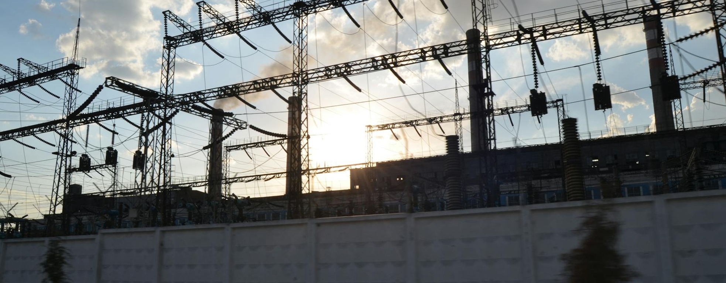
District Mini-Grid Electricity Distribution and Billing System (5000W)
This presentation will provide an overview of a project to develop a modern, efficient electricity distribution and billing system for a district-level mini-grid network with a capacity of 5000W.

Slide 3
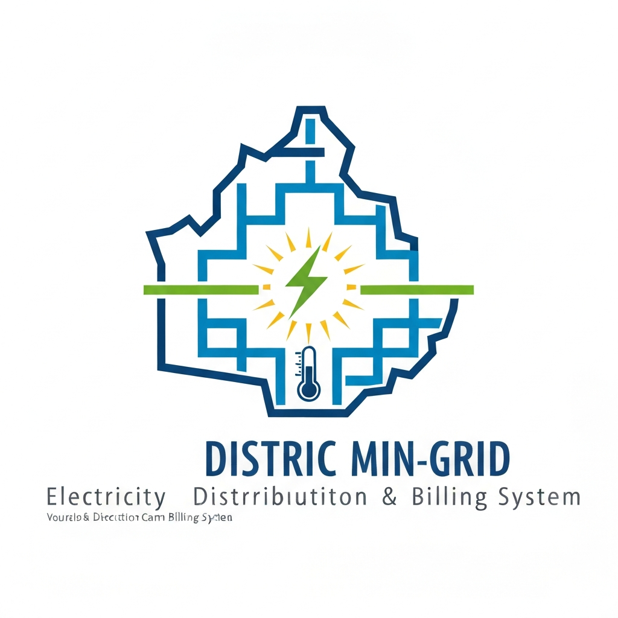
District Mini-Grid Electricity Distribution and Billing System
A professional presentation for a project that aims to improve the efficiency of electricity distribution and billing in a district-level mini-grid system with a capacity of 5000W.

Slide 4
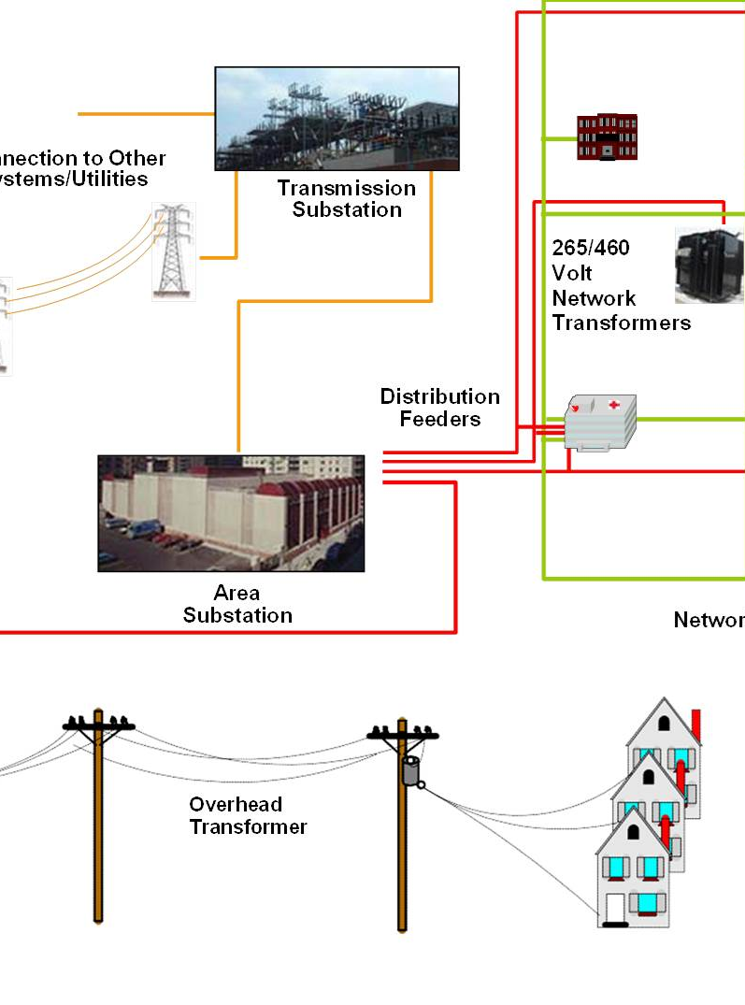
Problem Statement
The district mini-grid electricity distribution and billing system project aims to address the challenge of providing reliable and efficient electricity services to the local community. The current system faces issues such as uneven distribution, high technical and commercial losses, and inadequate billing and collection processes, resulting in poor customer satisfaction and financial sustainability.

Slide 5
Objectives
Improve Electricity Distribution Efficiency
Optimize the electricity distribution network to minimize losses and ensure reliable power supply to consumers.
Enhance Billing Accuracy and Transparency
Develop a robust billing system that accurately measures and records electricity consumption, ensuring fairness and transparency for consumers.
Increase Revenue Collection
Implement effective strategies to improve revenue collection, such as reducing non-technical losses and improving payment compliance.
Enhance Consumer Satisfaction
Provide a seamless and customer-friendly electricity distribution and billing experience, addressing consumer concerns and improving overall satisfaction.
Utilize Data-Driven Decision Making
Leverage data analytics and key performance indicators to guide operational decisions and optimize the mini-grid system's performance.

Slide 6





System Overview
Overall System Architecture
Mini-Grid Power Generation
Distribution Network
Consumer Metering
Billing and Management System
Provide a high-level diagram or illustration depicting the overall system architecture, including the key components such as the mini-grid power generation, distribution network, consumer meters, and the central billing and management system.
Explain the mini-grid power generation system, including the renewable energy sources (e.g., solar, wind), energy storage, and the control and distribution mechanisms.
Describe the distribution network, including the feeder lines, transformers, and the grid management and monitoring system.
Outline the consumer metering system, including the smart meters, data collection, and integration with the central billing system.
Explain the central billing and management system, including the data processing, consumer information management, billing calculations, and reporting capabilities.

Slide 7


Key Metrics
Station
Consumers
Annual kWh
Urban
23,520
186,666,712
Semi urban
14,476
85,136,002
Industrial
8,266
203,269,920
*Electricity Distribution Company Annual Report 2022

Slide 8






Area-wise Performance
Electricity distribution and billing performance in urban, semi-urban, and industrial estate areas (in percentage)
55%
25%
20%
Urban
Semi-Urban
Industrial Estate

Slide 9
Consumer Segmentation
Residential
Commercial
Breakdown of electricity consumption and billing for residential consumers, including households, apartments, and other residential dwellings.
Analysis of electricity usage and billing for commercial establishments, such as shops, offices, and small businesses.
Industrial
Agricultural
Evaluation of electricity distribution and consumption patterns for industrial consumers, including manufacturing facilities, warehouses, and factories.
Examination of electricity usage and billing for agricultural consumers, including farms, irrigation pumps, and other agricultural operations.

Slide 10







Top 10 Revenue Feeders
1
Feeder A
2
Feeder B
3
Feeder C
4
Feeder D

Slide 11






Household Consumption Summary
1
Analyze household-level electricity consumption data
2
Identify patterns and trends in electricity usage by household
3
Categorize households based on consumption levels (low, medium, high)
4
Assess the impact of billing structure and pricing on household electricity costs
5
Provide recommendations for targeted energy efficiency programs
6
Propose strategies to improve household-level energy management

Slide 12
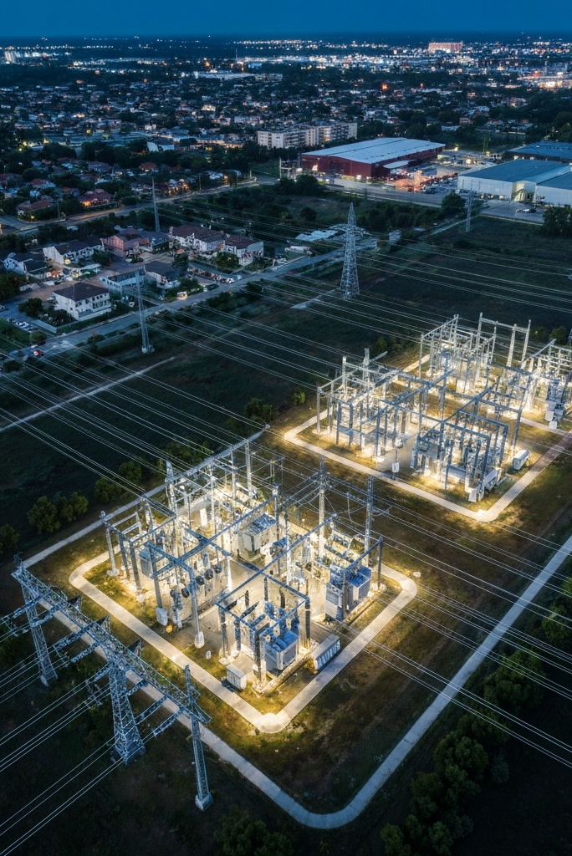
Conclusion:
The project has successfully implemented a comprehensive district mini-grid electricity distribution and billing system, delivering improved efficiency, consumer satisfaction, and revenue generation. Key findings include optimized area-wise performance, effective consumer segmentation, and identification of top revenue-generating feeders. Moving forward, the team recommends exploring renewable energy integration, advanced metering infrastructure, and data-driven decision-making to further enhance the system's capabilities and sustainability.

Slide 13
Any Question
?

